Slide 1



UNIVERSITY INSTITUTE OF ENGINEERING
COMPUTER SCIENCE ENGINEERING
Bachelor of Engineering
Theory of Computation (CST-353)
Topic: Arden’s Theorem
DISCOVER . LEARN . EMPOWER

Slide 2
Learning Objectives & Outcomes
Objective:
To understand the concept of Arden’s Theorem.
Outcome:
Student will understand the
  Arden’s Theorem

Slide 3
Arden’s Theorem
In order to find out a regular expression of a Finite Automaton, we use Arden’s Theorem along with the properties of regular expressions.
Statement −
Let P and Q be two regular expressions.
If P does not contain null string, then R = Q + RP has a unique solution that is R = QP*

Slide 4
PROOF
  R = Q + (Q + RP)P [After putting the value R = Q + RP]
  = Q + QP + RPP
  When we put the value of R recursively again and again, we get the following equation −
  R = Q + QP + QP² + QP³…..
  R = Q (ε + P + P² + P³ + …. )
  R = QP* [As P* represents (ε + P + P2 + P3 + ….) ]
  Hence, proved.

Slide 5

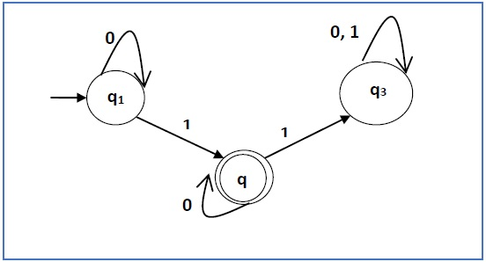
Construct a regular expression corresponding to the automata given below −

Slide 6
Solution −
Here the initial state is q₁ and the final state is q₂
Now we write down the equations −
q₁ = q₁0 + ε
q₂ = q₁1 + q₂0
q₃ = q₂1 + q₃0 + q₃1
Now, we will solve these three equations −
q₁ = ε0* [As, εR = R]
So, q₁ = 0*
q₂ = 0*1 + q₂0
So, q₂ = 0*1(0)* [By Arden’s theorem]
Hence, the regular expression is 0*10*.

Slide 7
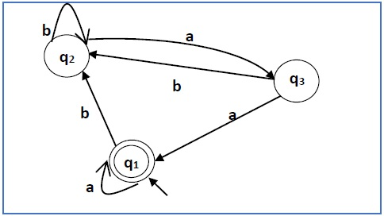
Construct a regular expression corresponding to the automata given below −

Slide 8
Solution −
Here the initial state and final state is q₁.
The equations for the three states q1, q2, and q3 are as follows −
q₁ = q₁a + q₃a + ε (ε move is because q1 is the initial state0
q₂ = q₁b + q₂b + q₃b
q₃ = q₂a
Now, we will solve these three equations −
q₂ = q₁b + q₂b + q₃b
= q₁b + q₂b + (q₂a)b (Substituting value of q₃)
= q₁b + q₂(b + ab)
= q₁b (b + ab)* (Applying Arden’s Theorem)
q₁ = q₁a + q₃a + ε

Slide 9
q₁a + q₂aa + ε (Substituting value of q₃)
= q₁a + q₁b(b + ab*)aa + ε (Substituting value of q₂)
= q₁(a + b(b + ab)*aa) + ε
= ε (a+ b(b + ab)*aa)*
= (a + b(b + ab)*aa)*
Hence, the regular expression is (a + b(b + ab)*aa)*.

Slide 10
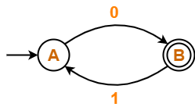
Find regular expression for the following DFA using Arden’s Theorem-

Slide 11
Solution-
Step-01:
Form a equation for each state-
A = ∈ + B.1 ……(1)
B = A.0 ……(2)
Step-02:
Bring final state in the form R = Q + RP.
Using (1) in (2), we get-
B = (∈ + B.1).0
B = ∈.0 + B.1.0
B = 0 + B.(1.0) ……(3)
Using Arden’s Theorem in (3), we get-
B = 0.(1.0)*
Thus, Regular Expression for the given DFA = 0(10)*

Slide 12
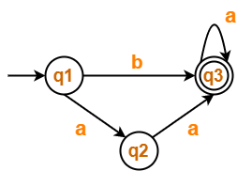
Find regular expression for the following DFA using Arden’s Theorem-

Slide 13
Solution-
Step-01:
Form a equation for each state-
q1 = ∈ ……(1)
q2 = q1.a ……(2)
q3 = q1.b + q2.a + q3.a …….(3)
Step-02:
Bring final state in the form R = Q + RP.
Using (1) in (2), we get-
q2 = ∈.a
q2 = a …….(4)
Using (1) and (4) in (3), we get-
q3 = q1.b + q2.a + q3.a
q3 = ∈.b + a.a + q3.a
q3 = (b + a.a) + q3.a …….(5)
Using Arden’s Theorem in (5), we get-
q3 = (b + a.a)a*
Thus, Regular Expression for the given DFA = (b + aa)a*

Slide 14
Summary
Arden’s Theorem
  Conversion of FA to R.E

Slide 15
References
K.L.P MISHRA,“Introduction to computer Theory” .
https://www.tutorialspoint.com/automata_theory/ardens_theorem.htm

Slide 16
THANK YOU

